Slide 1


From Southern Careers Institute

Slide 2
Mary
Krista
She has an Associate’s Degree in Accounting Technology & working towards a Certificate in Data Science.
She currently works as an employee at an Accounting Office.
She Is knowledgeable about Accounting and Computers. However, she is more interested in learning about programming and data analysis.
With a diverse background in Internet security, graphic design, web development, and entrepreneurship, pursuing a career in data science has become her ultimate ambition.
Having gained extensive experience as a business owner and professional in various fields, she has prioritized being an employee using the Data Science skills she learned.
Kori
Christophe
Is employed as an Inventory Specialist and pursuing a career outside of retail
He has always had an interest in learning to program and data analysis but afraid to take that first step until now.
In regards to his knowledge and understanding of data analysis and programming he is a beginner
She is currently employed as a Correspondence Administrator and pursuing a Data Science Career.
Is currently learning Data science to enhance her life and make a career change.
She is slightly knowledgeable of stock price trends and currently pursuing more knowledge.

Slide 3
NYSE History Summarized 2000-2021 Part One
The New York Stock Exchange, one of the world's oldest and most iconic stock markets which has experienced significant developments and changes.
Technological Advancements: In 2006, the NYSE introduced its electronic trading platform, known as NYSE Arca, which facilitated electronic trading of stocks and exchange-traded funds. This marked a shift from the traditional open outcry auction-style trading that the NYSE was known for.
9/11 Attacks: The terrorist attacks on September 11, 2001, resulted in the temporary closure of the NYSE for several days, marking one of the longest closures in its history. However, the exchange reopened on September 17, 2001, demonstrating resilience and determination.
Regulatory Changes: The NYSE experienced significant regulatory changes during this period. In response to corporate scandals, such as Enron and WorldCom, the Sarbanes-Oxley Act was enacted in 2002, imposing stricter financial reporting and governance standards on publicly traded companies.
Financial Crisis of 2008: The global financial crisis of 2008 had a profound impact on the NYSE. The exchange witnessed extreme market volatility, and several major financial institutions, including Lehman Brothers and Bear Stearns, faced collapse. The crisis led to increased regulatory scrutiny and changes in market structure.
Evolution of High-Frequency Trading: High-frequency trading gained prominence involving the use of advanced technology and algorithms for rapid trading. HFT became a significant part of the NYSE's trading landscape. Raising concerns about market integrity, fairness, and stability.

Slide 4
NYSE History Summarized 2000-2021 Part Two
Demutualization and IPO: In 2005, the NYSE completed its demutualization process, transforming from a member-owned organization to a publicly traded company. In 2006, the NYSE went public through its initial public offering (IPO), becoming a publicly traded company under the ticker symbol "NYX."
Advances in Market Data and Connectivity: Market data became more accessible and faster, enabling investors to make more informed decisions. Connectivity improved with the development of new trading technologies and the expansion of electronic trading platforms, providing investors with greater access to the NYSE.
COVID-19 Pandemic: The COVID-19 pandemic, which emerged in early 2020, caused the exchange to experience extreme market volatility and witnessed temporary closures of its physical trading floor due to social distancing measures.
Despite the challenges and changes, the NYSE remained a leading stock market during the period from 2000 to 2021. It continued to play a pivotal role in global finance, facilitating the buying and selling of stocks for investors around the world, and adapting to the evolving landscape of technology, regulations, and market dynamics.

Slide 5
Goldman Sachs History Summarized Part One
Goldman Sachs Group Inc. is a global investment banking, securities, and investment management firm headquartered in New York City.
2000: Goldman Sachs became a publicly traded company and began trading on NYSE under the symbol “GS”.
2008: Like many other financial institutions, Goldman Sachs faced challenges during the 2008 financial crisis. In September 2008, Goldman Sachs converted from an investment bank to a bank holding company to gain access to additional funding from the Federal Reserve.
2010: Goldman Sachs faced allegations from the U.S. Securities and Exchange Commission regarding its marketing and sale of a collateralized debt obligation called Abacus. Goldman Sachs settled the case for $550 million without admitting or denying the allegations.
2012: Goldman Sachs announced a strategic plan to cut costs and increase profitability, including cutting 1,300 jobs and reducing non-compensation expenses by $1.9 billion annually.
2013: David Solomon was appointed as the new CEO, succeeding Lloyd Blankfein, who had served as CEO since 2006.

Slide 6
Goldman Sachs History Summarized Part Two
2017: A digital consumer lending platform called Marcus, offering personal loans and savings accounts to retail customers was offered.
2018: Goldman Sachs announced plans to expand its presence in Europe by opening a new office in Frankfurt Germany as part of its Brexit contingency planning.
2020: In February 2020, the Covid pandemic caused the stock market to crash. Goldman Sachs faced regulatory scrutiny over its involvement in the high-profile corruption scandal involving a Malaysian sovereign wealth fund. GS agreed to pay $2.9 billion in settlements to various authorities, including the U.S. Department of Justice, to resolve the matter.
2021: GS reported record profits in the first quarter of 2021, driven by strong performance in its investment banking and trading divisions.
Throughout the years, Goldman Sachs has been involved in various mergers and acquisitions, capital market transactions, and investment management activities, as well as facing regulatory and legal challenges. It has also made strategic moves to expand its business lines and adapt to changing market conditions.

Slide 7
Questions to be answered
Which stock is the most volatile?
How does the unemployment rate affect stocks?
What happens when the stock market crashes?
How do multiple variables play a part in the stock market?
What trends can we see with the data?
Can we forecast stocks based off the data?

Slide 8
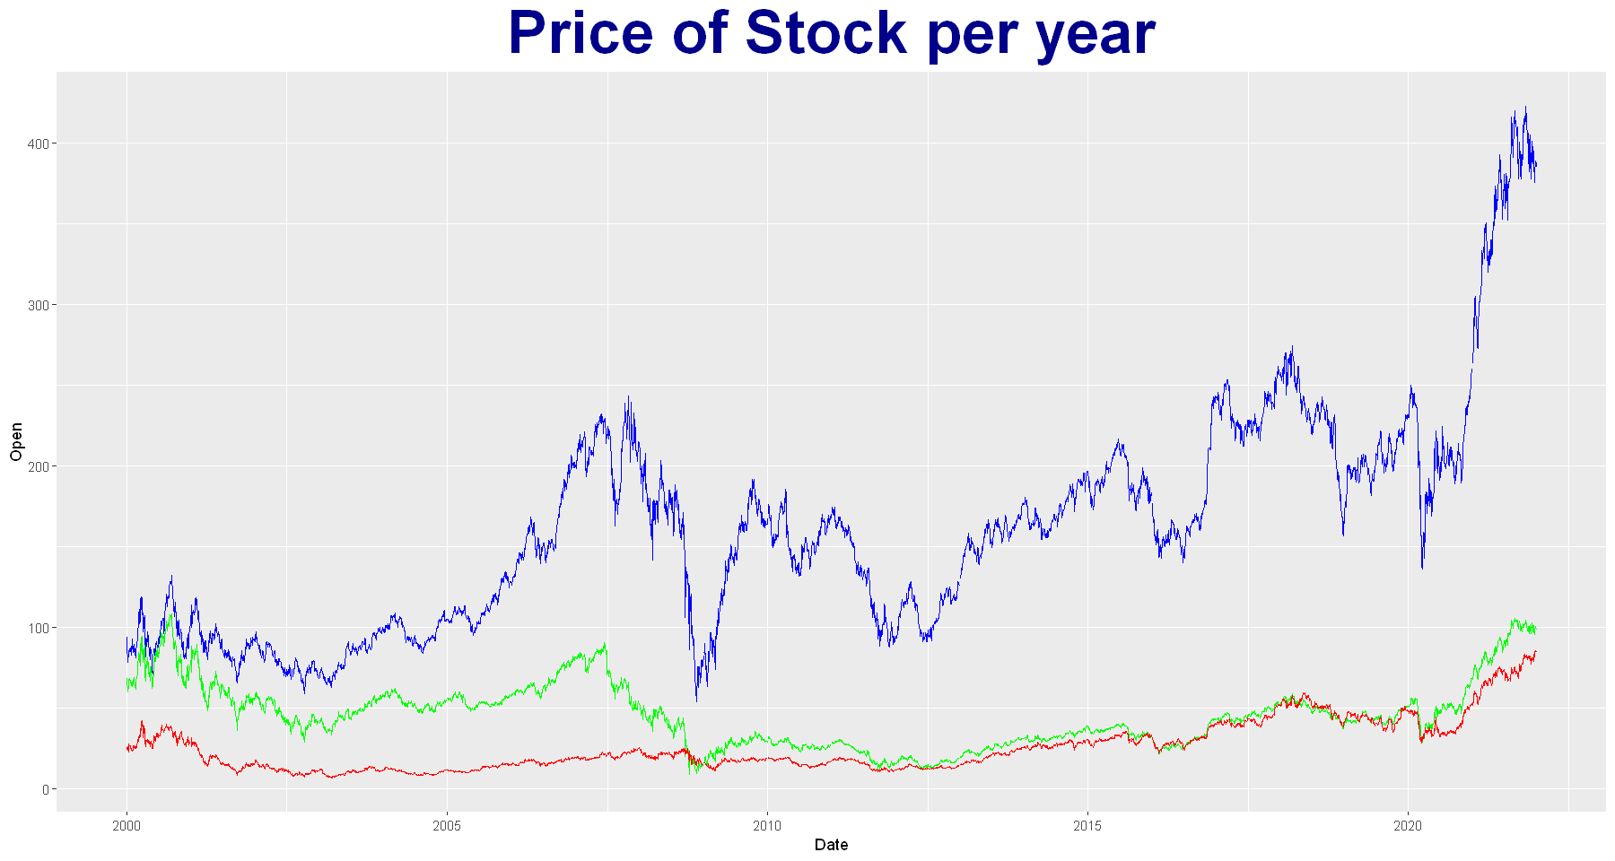
Goldman Sachs (blue)
Morgan Stanley (green)
Schwab (red)
Notes:
Mary: The graph show the stock prices for each year and the volatility regarding the stock. When speaking about stock volatility, you are looking at the rate in which a stock increases or decreases over a particular period. Goldman Sachs is the most volatile since the stock prices are a lot higher and have more risk than the stocks for Morgan Stanley and Schwab. Looking at the graph, you can see that Schwab would be the best stock option to buy when it comes to the volatility between the stock.

Slide 9
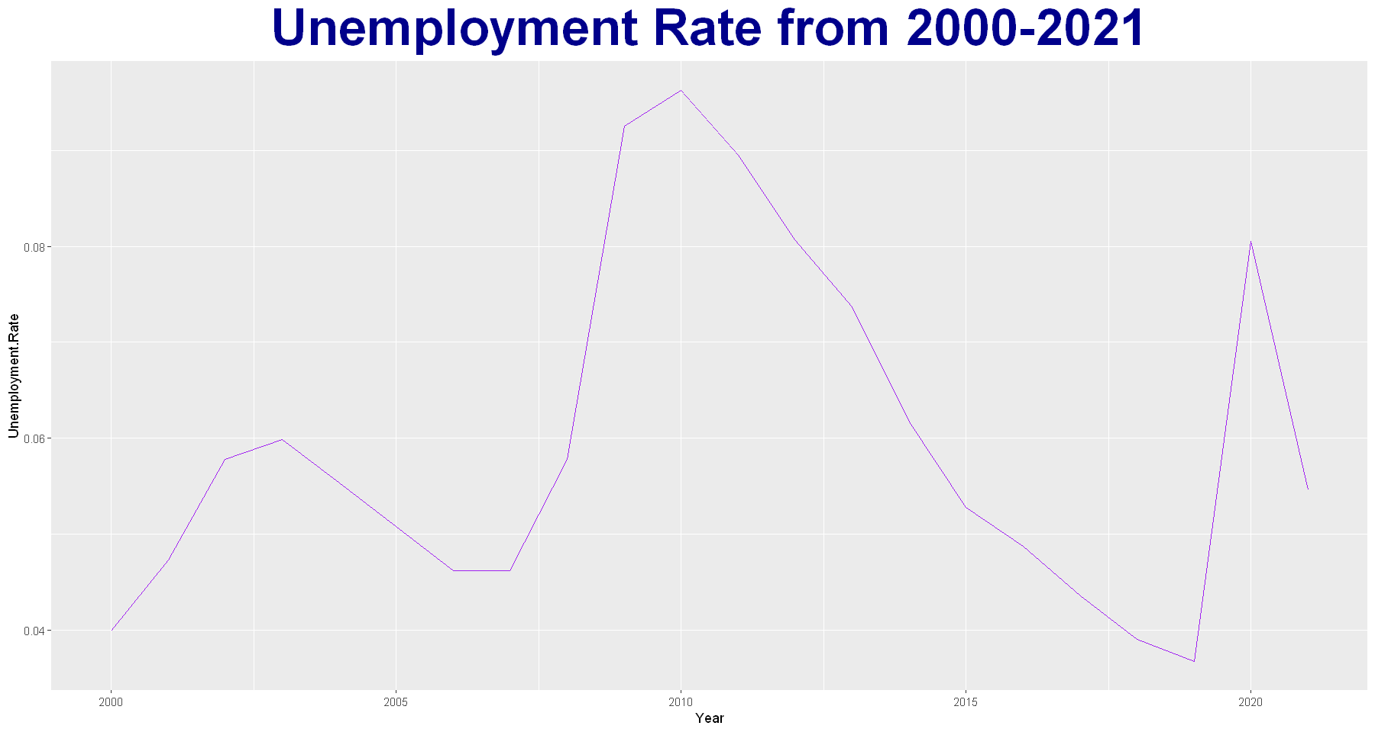
Highest Unemployment Rate in 2010 – 9.6%
During the slow economic growth after the Great Recession
Second Highest Unemployment Rate in 2020 – 8.1%
Cause Feds to reduce interest rates
Notes:
Mary: The Unemployment Rate also played a factor in the rise & fall of the stocks. As the unemployment rate went up, the stock prices also increased. The Feds would lower interest rates which would in turn cause investors to buy more stocks.
Highest Unemployment Rate is in 2010, which is during the slow economic growth after the Great Recession.

Slide 10
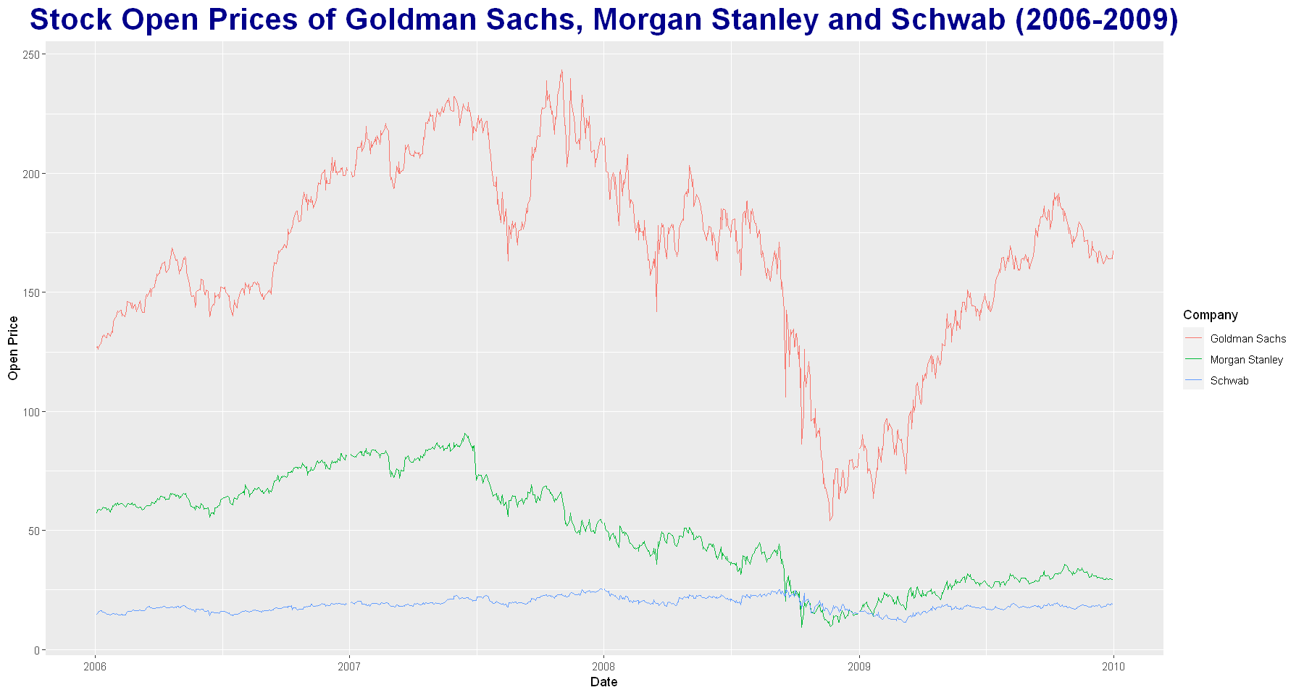
Housing Market Crash
Highest Unemployment Rate
Great Recession
Notes:
Mary: When the Housing Market Crashed in 2006, more demand for stocks led to increased prices in stocks. As the Great Recession hit, the demand for stocks decreased therefore, the price decreased based off the demand of the stocks.
The predatory home loan private lending driven by the insatiable investor demand for mortgage-related investments that led up to the crash in 2008.
At the beginning of the Great Recession (December 2007), stock prices were up due to more demand of stocks. The stocks fluctuate throughout the first part of 2008 as the recession went on, stocks were not bought as much. September of 2008, Goldman Sachs stocks started going down at a faster pace than Morgan Stanley and Schwab due to stocks being sold due to less demand. Near the end of the Recession in 2008, the demand for stocks started going up again. The Stock prices continued to rise through most of 2009, even after the Housing Market Crash ended July 2009.

Slide 11
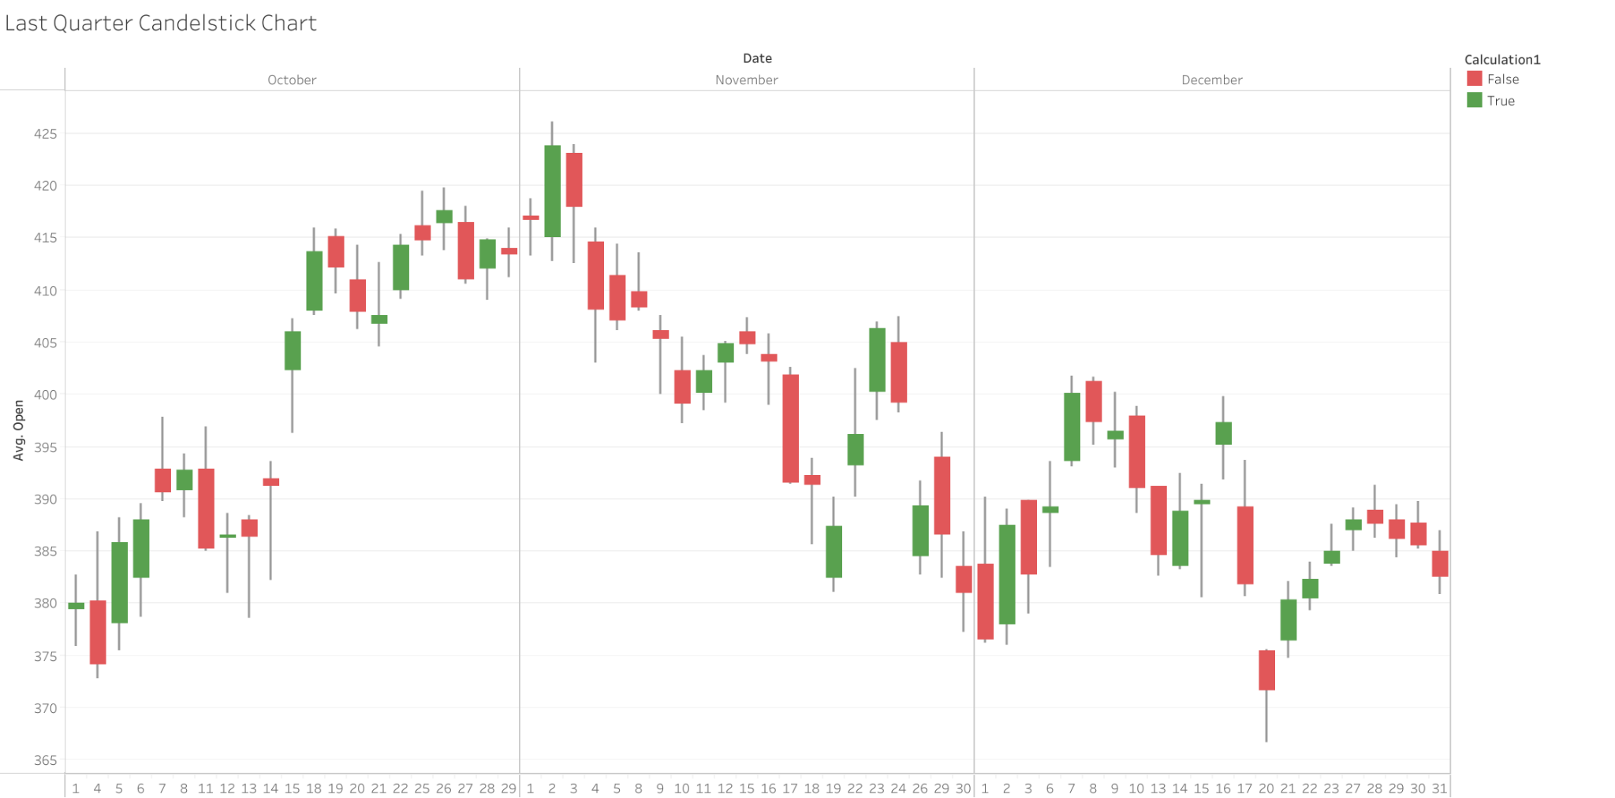
Results - Kori
Goldman Sachs 2021
Resistance
Resistance
support
support
support
Notes:
Support lines represent prices where the market had difficulties to break below
Resistance levels are similar to support levels, only that they represent price-levels at which the price had difficulties to break above. This signals that the same level could again act as a resistance, or barrier, for the price to move higher. While buy orders are located around important support levels, sell orders are clustered around important resistance levels.
The last quarter for GS produces a selling trend may not stay that way when 2022 comes. It will change once the resistance hits for a long time, usually the trend changes course. This also depends on upcoming news.
For a support or resistance level to be important, the price should touch the level at least three times.

Slide 12
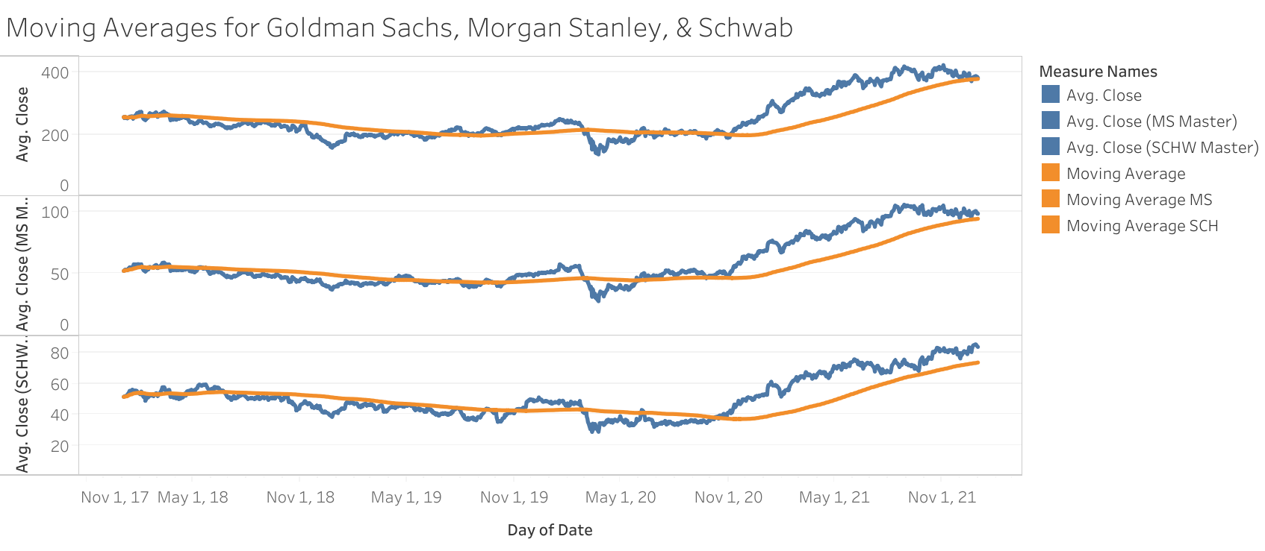
MACD Indicator with prices
January 3rd 2018
$253.3
Starting price
Feb. 27, 2020
$214.50
November 6th, 2020
$198.20
April 9th, 2019
$44.98
Feb. 27, 2020
$46.31
January 2nd, 2018
$52.19
Starting price
May 26, 2020
$43.69
January 2nd, 2018
$51.44
Starting price
June 22nd, 2018
$54.61
Trend change -selling
November 28th, 2019
$42.38
buy
Oct. , 2020
$37.81 —----Hold
February 24th, 2020
$43.18
Notes:
Moving average convergence divergence looked at from 200 prior days.
We are looking at asset momentum to see if the trend is up or down and when we should have entered the next price trend.
Also what is the next possible price to buy in.
Please keep in mind as the companies price may move up or down. Money can be made both ways with both upward or downward.
With the pandemic impacting everyone the next best possible price to buy in would have been at 198.20 for the upward trend in Goldman Sachs and $43.69 for Morgan Stanley.
I would pull out of that buy once the last quarter begins for GS and MS
For Schwab the next best price would be too enter at the last quarter of 2020 and hold through 2021 for yearly trading.

Slide 13
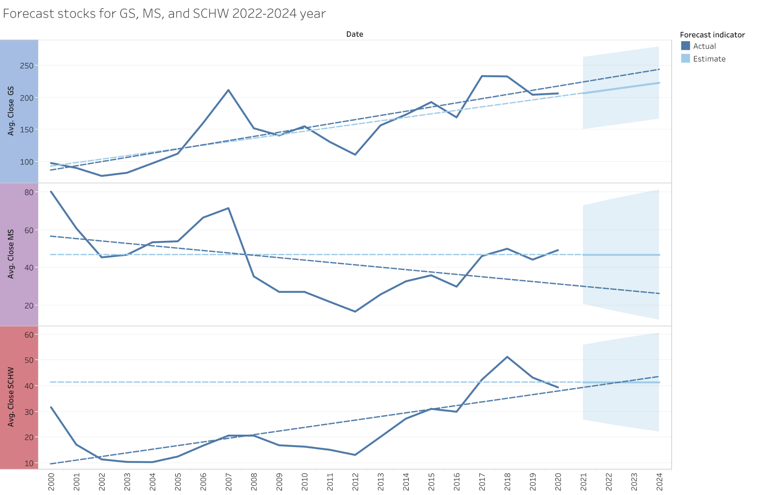
Forecast predictions
From 2000 until 2024
Notes:
The upcoming trends through 2022 - 2024 for GS has went into a bullish movement. Its predictions show the same.
The predicted trends through 2022 - 2024 for Morgan Stanley has went into a consolidated movement but the actual movement shows a bullish movement. The Actual trend indicated a bearish trend.
The upcoming trends through 2022 - 2024 for SCHW has went into a bullish movement and continues.

Slide 14
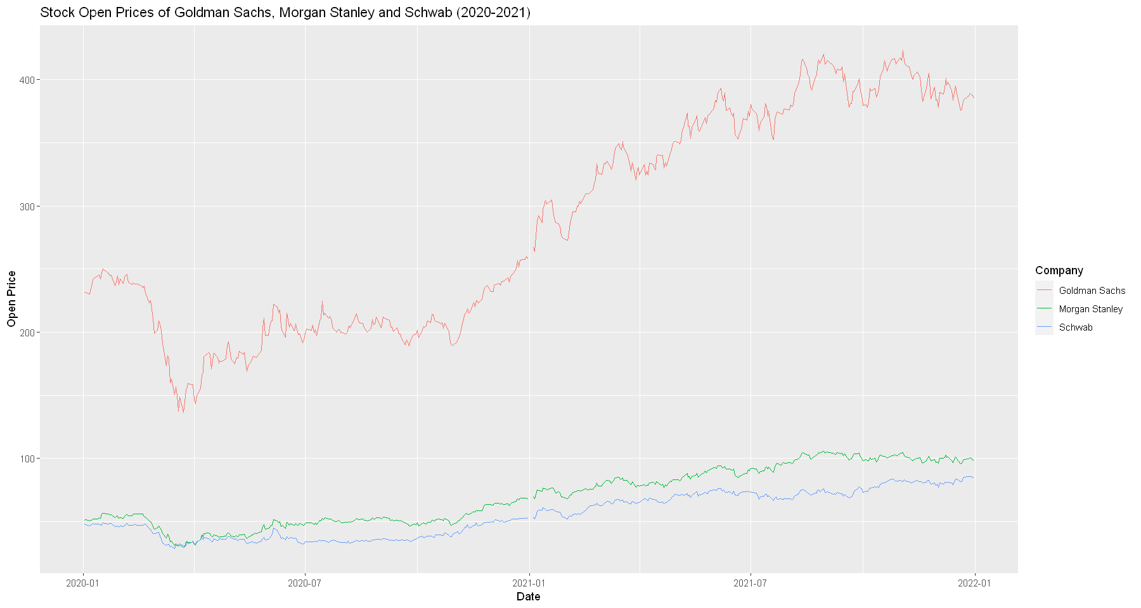
Results - Christophe
February 2020 decline due to stock market crash from Covid
Summer beginning increase due to Feds lowering interest rates causing investors to invest instead of sell.
Notes:
Christophe: In the beginning of 2020 all 3 stocks saw a sharp decline around February. Due to the increase in cases of Covid the World Health Organization declared a global pandemic which saw business closing and a rise in unemployment rate. In turn the Federal Government lowered interest rates which saw investors doing the opposite of what they usually do during a crash which was invest rather than sell. This growth is shown during the summer of 2020 as all three stocks begin to show a small increase. Over time as the Federal Government passed multiples bills to help stimulate the economy investors saw this as a push to further continue investing in and holding their stocks rather than selling said stocks.

Slide 15
Summary
When it comes to the volatility of a stock, it would be wiser to choose a less volatile stock which will reduce the risk of financial loss.
From 2006-2010, the Housing Market, the Great Recession, and the Unemployment Rate affected the stock market.
The Unemployment Rate would play a factor in the rise & fall of stocks causing the Feds to lower interest rates resulting in investors buying more stocks
Goldman Sachs’ trend will continue to sell into early 2022
Morgan Stanley’s trend will forecast selling starting in 2022
Schwab’s trend will forecast buying starting in 2022
Forecasting is not 100% since news, stock market crashes, etc can change the stock prices
In February 2020, the Covid pandemic caused the stock market to crash. Summer of 2020 is when the stock market growth started again, after the Unemployment Rate reached a high.
Notes:
Mary

Slide 16
Conclusion
By looking at several of the graphs, we are able to tell which one is more volatile as well as getting a better understanding as to whether we should buy, sell, or hold stocks.
We are able to understand and track trends, best times to buy/sell, and be able to forecast future prices.
The graphs show that multiple variables can affect stock prices at any given time..
By looking into the differences between multiple stocks, we were able to determine the minor/major differences between the higher risk stocks versus the lower risk stocks.
Forecasting is an estimate and does not predict variables that can alter the prices.
Trends can be found by looking not only at the data, but the events happening at the time of change in price.

Slide 17
Questions?

Slide 18
References
Chat GPT
U.S. Unemployment Rate 1991-2023 | MacroTrends
The Fall of the Market in the Fall of 2008

